Slide 1
LIVER DISEASE PREDICTION
NUSHRAT TANZEEM
1611107042

Slide 2
Introduction
This data set was downloaded from the UCI ML Repository which contains 11 attributes and 583 instances collected from North East of Andhra Pradesh, India. The "Dataset" attributes is the class attribute which will predict whether a person have liver disease or not.
Attributes:
Age of the patient
Gender of the patient
Total Bilirubin
Direct Bilirubin
Alkaline Phosphatase
Alamine Aminotransferase
Aspartate Aminotransferase
Total Proteins
Albumin
Albumin and Globulin Ratio
Dataset (Class attribute)

Slide 3
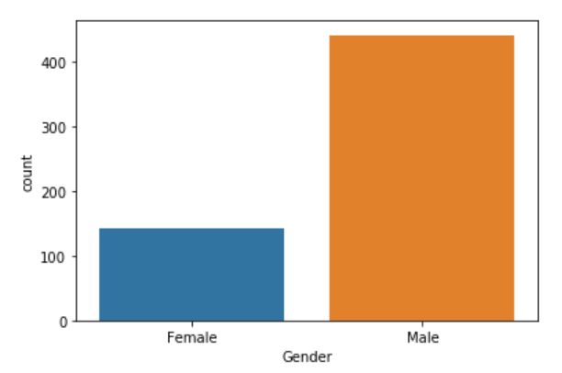
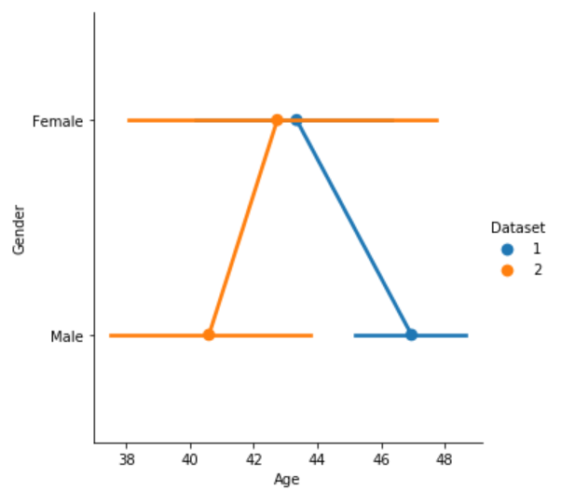
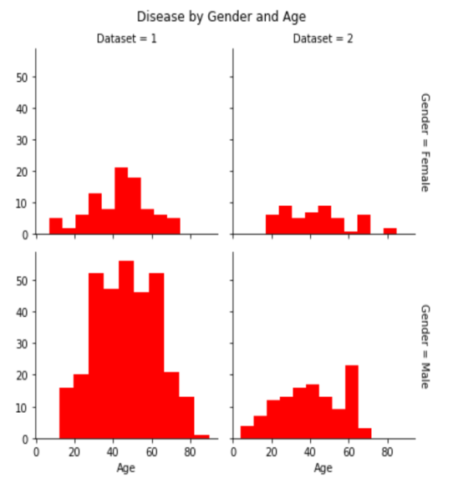
DATA ANALYSIS & VISUALIZATION
From the count plot, it is found that the number of male patients are 441 and the female patients are 142
Albumin Level and Bilirubin level is higher in case of male compared to female.
Age seems to be a factor for liver disease for both male and female genders
The age difference can be seen in the graphs

Slide 4
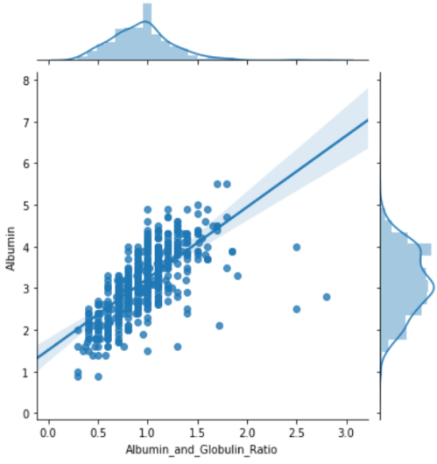
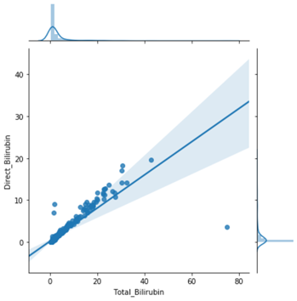
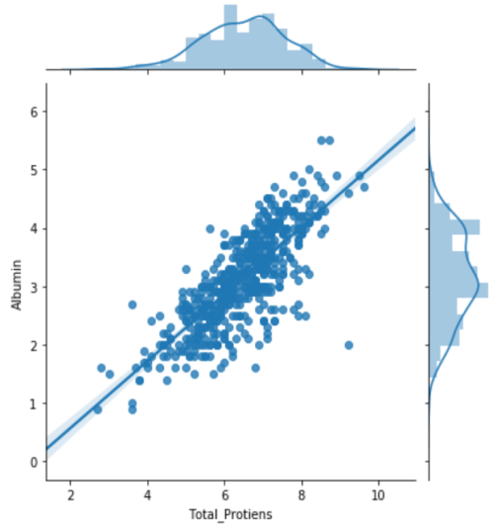
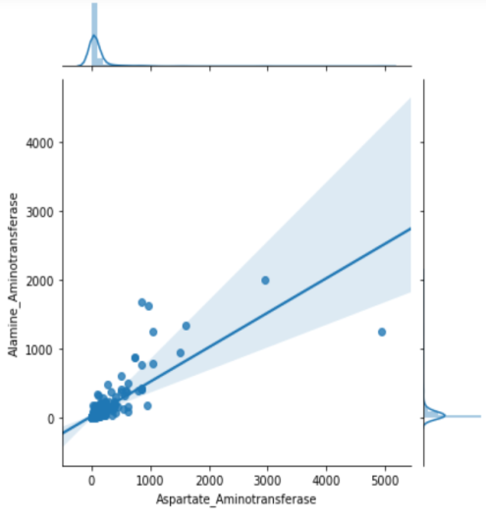
DATA ANALYSIS & VISUALIZATION

Slide 5
PRE-PROCESSING
There were 4 null values in the Albumin and Globulin Ratio column which was filled up by finding the mean of the all the instances of the attribute
Direct_Bilirubin, Alamine_Aminotransferase, Total_Protein attributes were omitted since their existence doesn’t make any difference to the accuracy.
The class attribute consist of two value: 1 and 2
1 means Yes
2 means No
So, exchanged the numerical value of “Dataset” to categorical value.

Slide 6
METHODOLOGY
SVM (Support Vector Machine) algorithm is used on the dataset.
The accuracy on training data is 99.50% and 73.14% on test data
Keeping the fact of relationship among the attributes of data analysis and visualization, Direct_Bilirubin, Alamine_Aminotransferase, Total_Protein attributes are omitted and SVM was applied. Then the accuracy obtained on training and test data are 99.75% and 73.14%. So they don’t contribute much to the accuracy of the dataset.

Slide 7
RESULT AND UPCOMING WORK
RESULT :
For SVM, the accuracy is
Training data = 99.75%
Test data = 73.14%
UPCOMING WORK :
A lot of pre-processing is necessary
Algorithms like logistic regression, random forest and so on will be applied.

Slide 8
Thank You

